Slide 1
Statistics and Machine Learning
IBM India Research Lab

Slide 2
Content
References:
Pattern Recognition and Machine Learning (Information Science and Statistics – Christopher Bishop
Duda, R. O., Hart, P. E.,, Stork, D. G. (2001). Pattern Classification. New York: Wiley. ISBN: 978-0-471-05669-0
N. G. Das, “Statistical Methods,” Tata McGraw-Hill Publishing Company Ltd., New Delhi, 2008.
Curve fitting
Bias and Variance
Introduction to Bayes Theorem
Bayes Classification – Naïve Bayes
Confidence Interval
Central Limit Theorem
Hypothesis testing

Slide 3
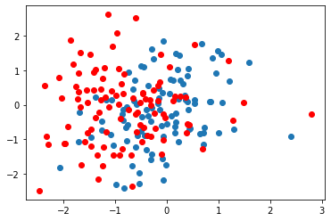
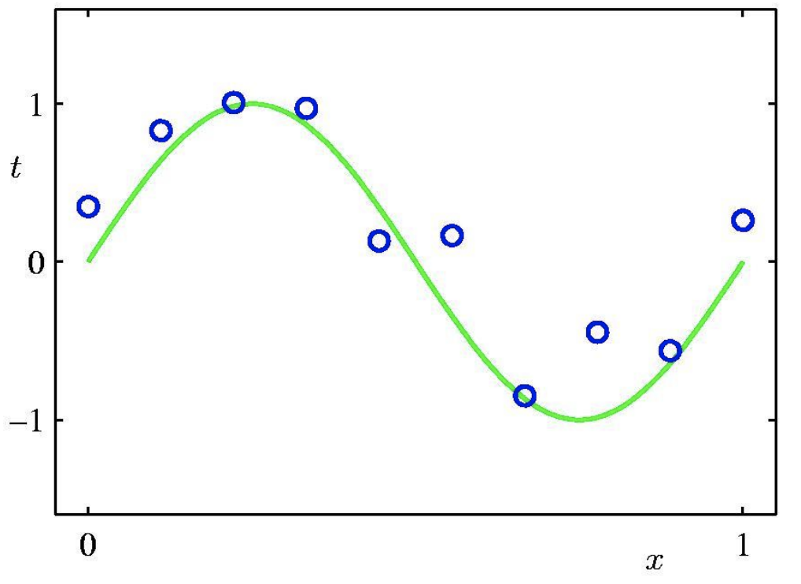
Need of Machine Learning
Represent training data in terms of parameters – Learn model parameters
Design inference strategies which result in minimum loss
Training example Testing example
Challenges:
Training data may not represent the entire population of data
Underlying distribution of the data is unknown
There may be noise present in the data/labels
Our assumption of the loss function may not be ideal for the dataset in hand

Slide 4
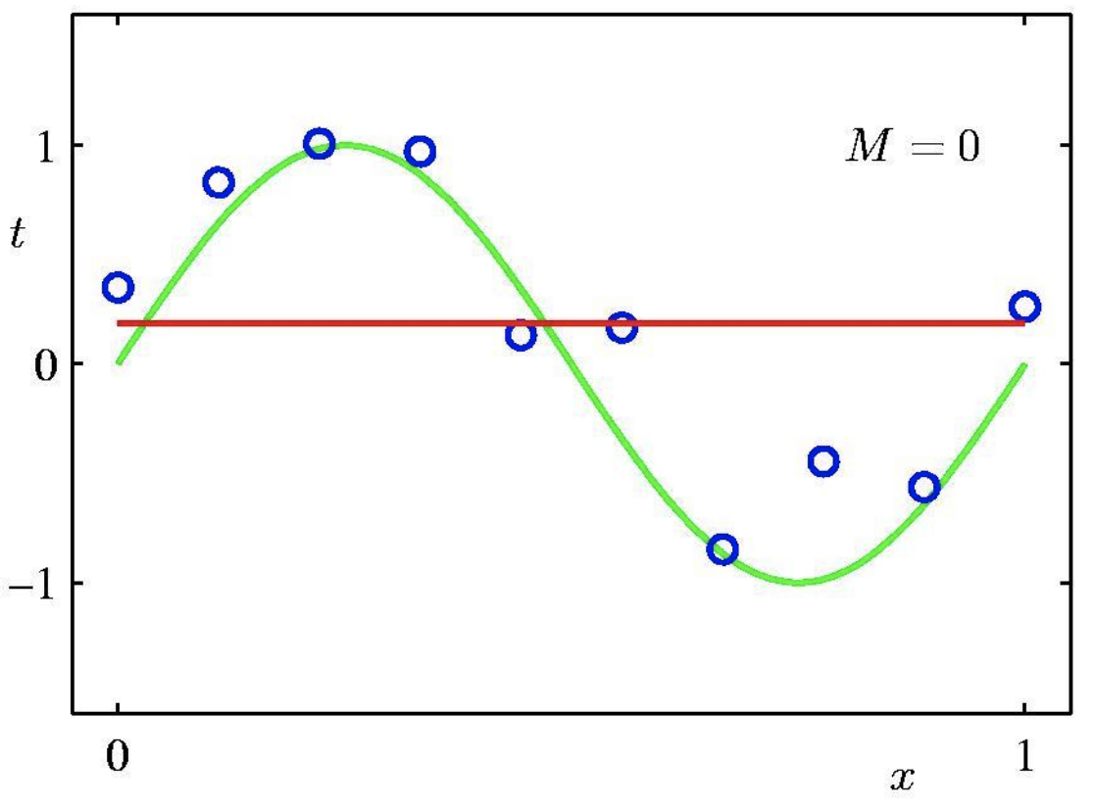
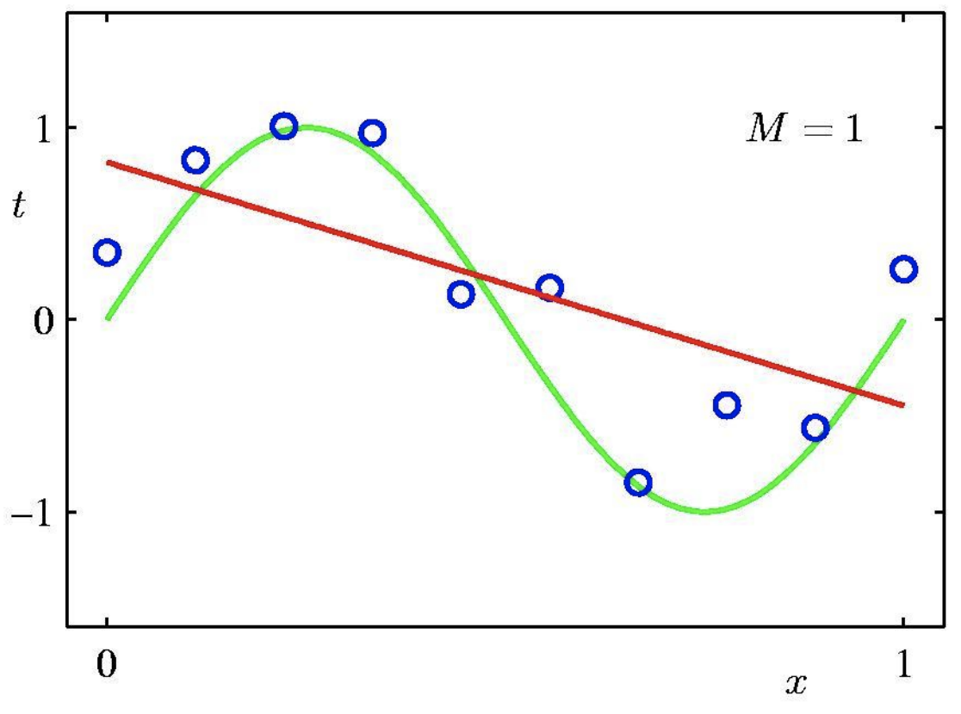
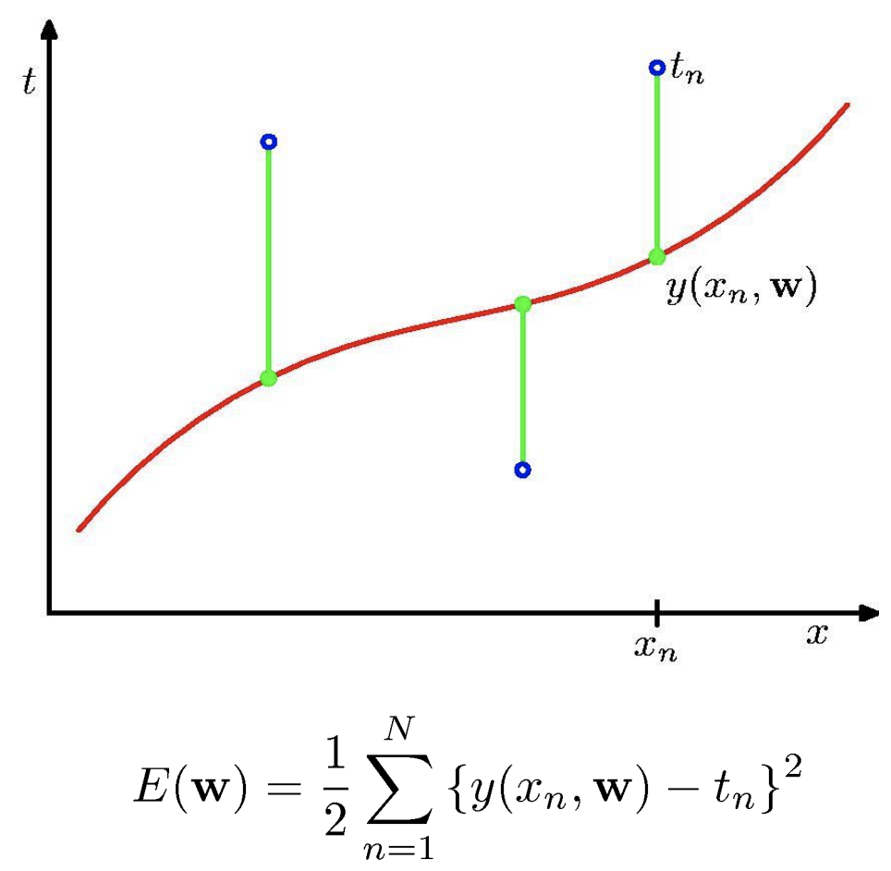
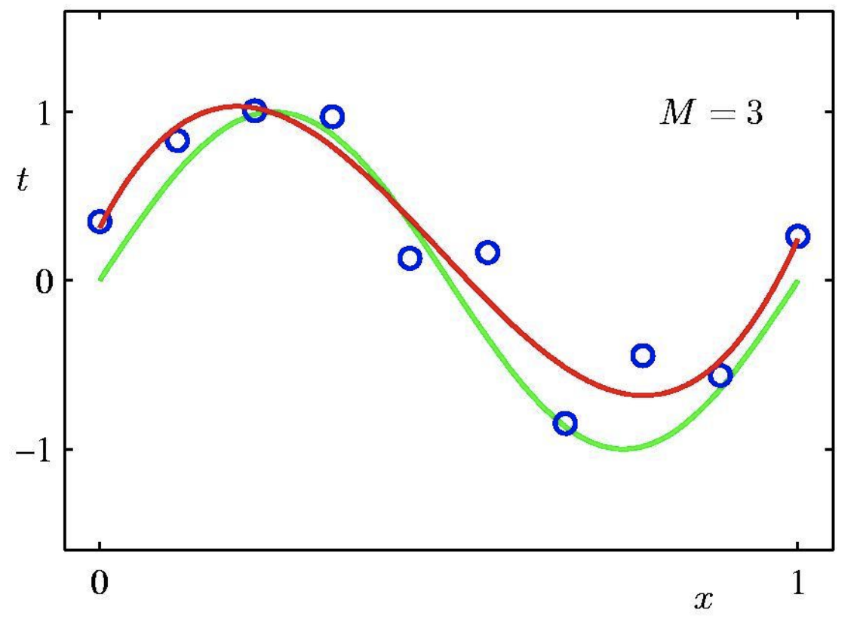
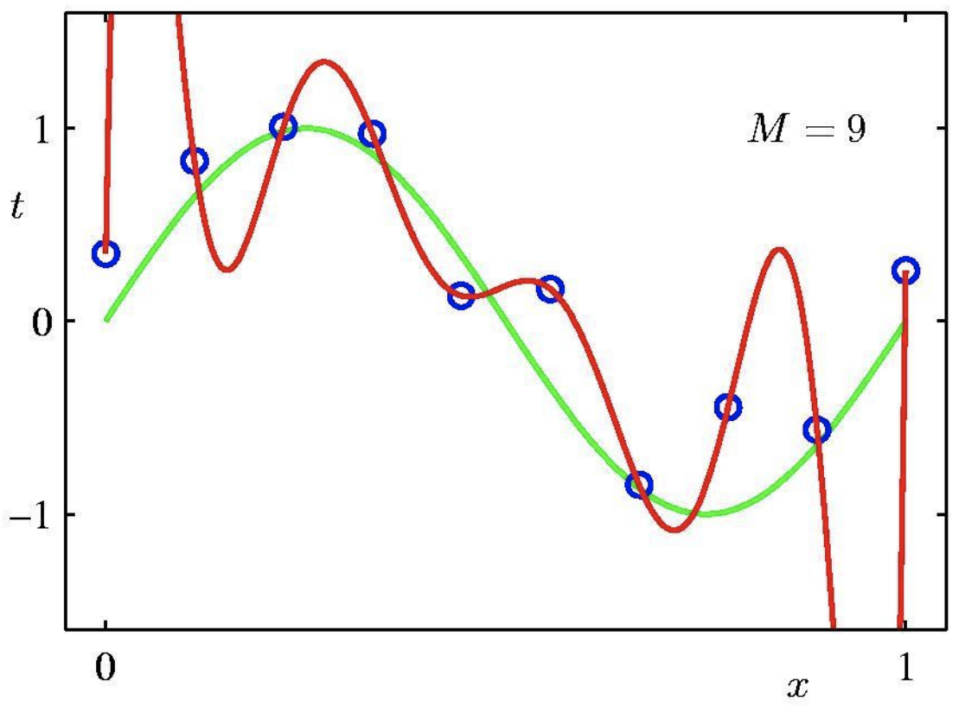
Curve Fitting
0th order polynomial
1st order polynomial
3rd order polynomial
9th order polynomial

Slide 5
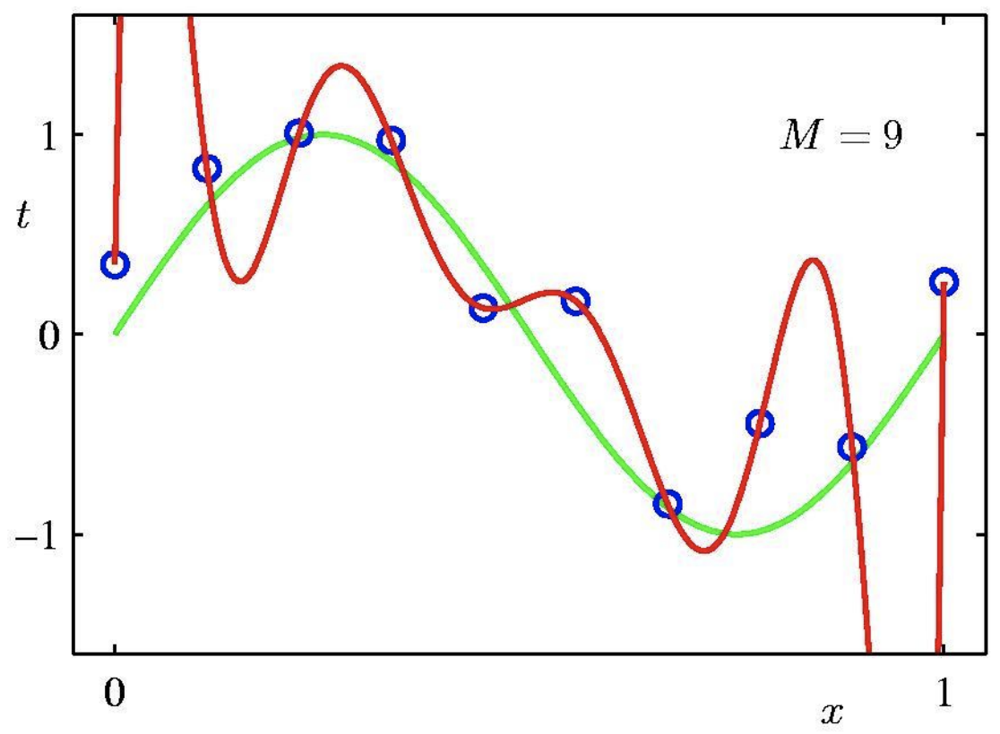
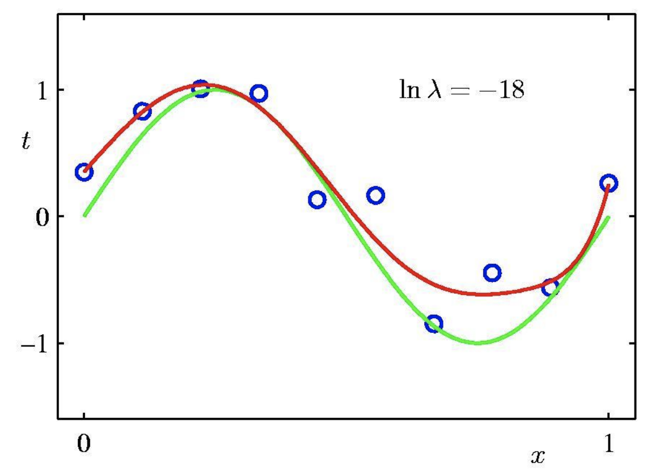
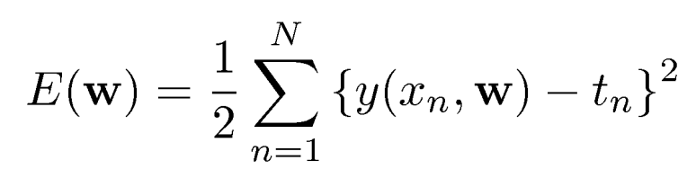
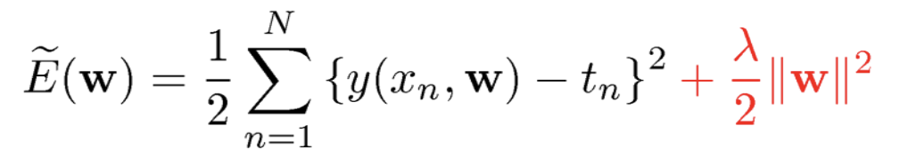
Regularizer
Penalize large coefficient values
Low Bias, High Variance
High Bias, Low Variance

Slide 6
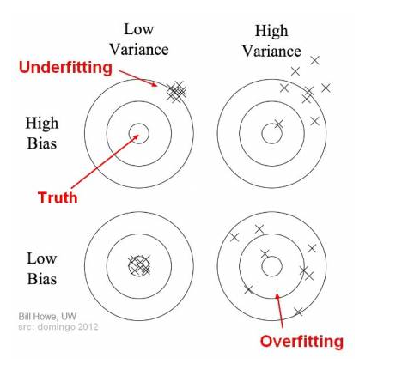
Bias vs Variance
Bias is the average difference between the prediction of the model and the true value to be predicted
High bias -> oversimplified model -> Underfitting
Variance is the ability of the model to learn a generalized solution.
High variance -> Complex model -> Overfitting
https://towardsdatascience.com/understanding-the-bias-variance-tradeoff-165e6942b229

Slide 7
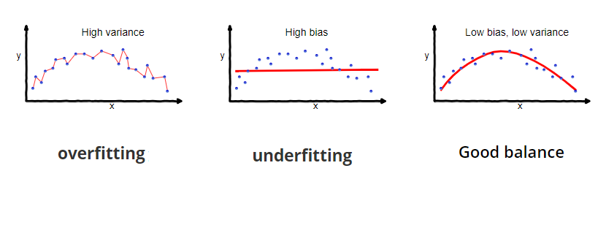
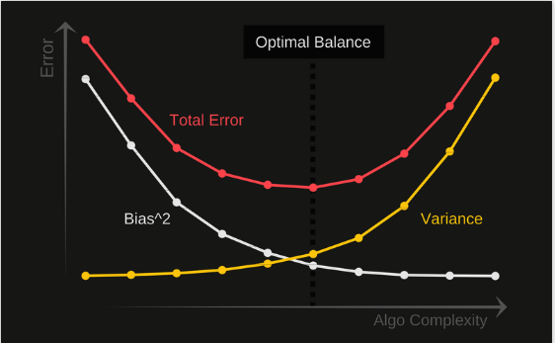
Bias Variance Tradeoff Helps us to decide the correct model to use for the given dataset
https://towardsdatascience.com/understanding-the-bias-variance-tradeoff-165e6942b229

Slide 8
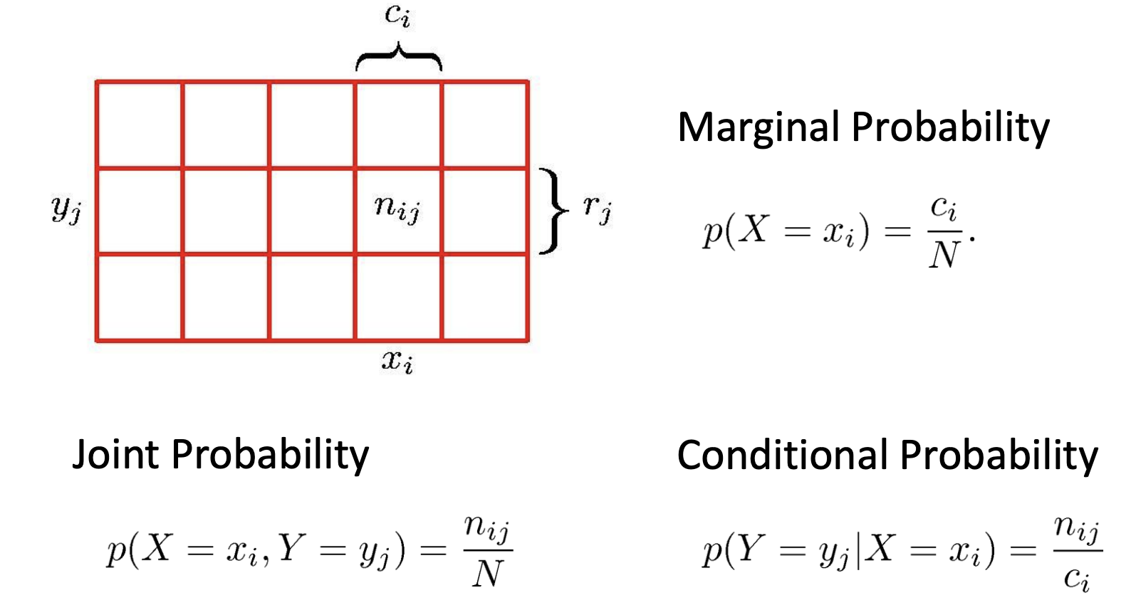
Introduction to Probability

Slide 9
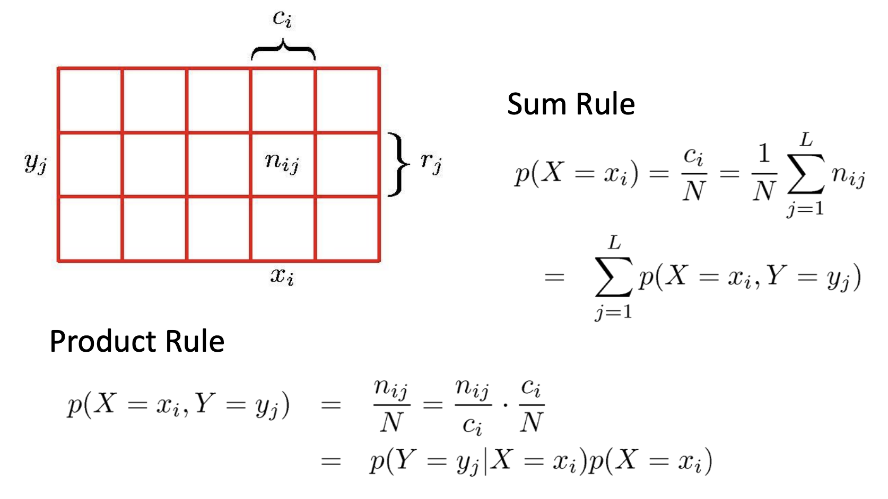
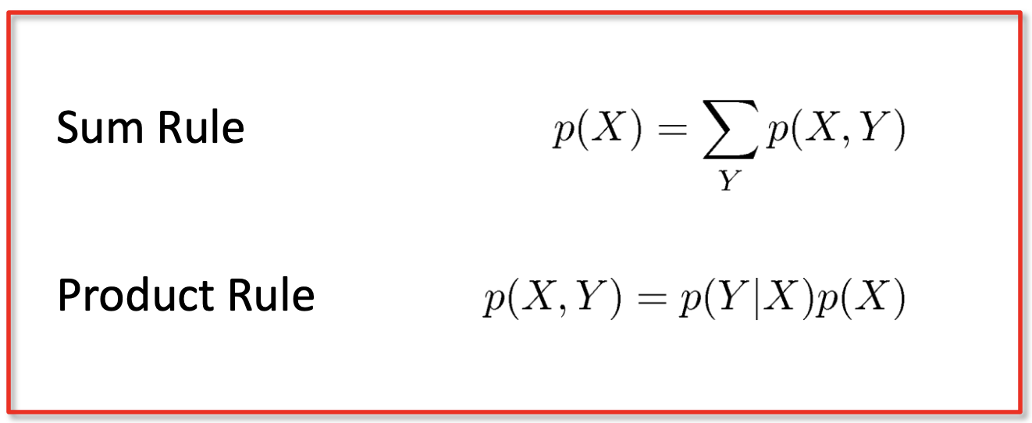
Probability Axioms

Slide 10
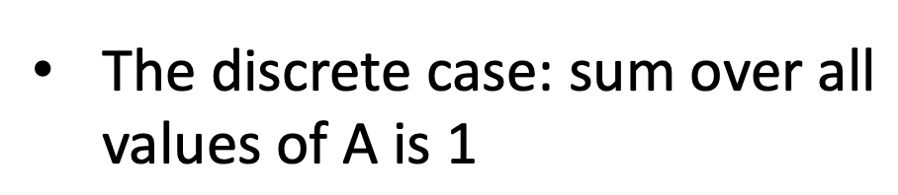
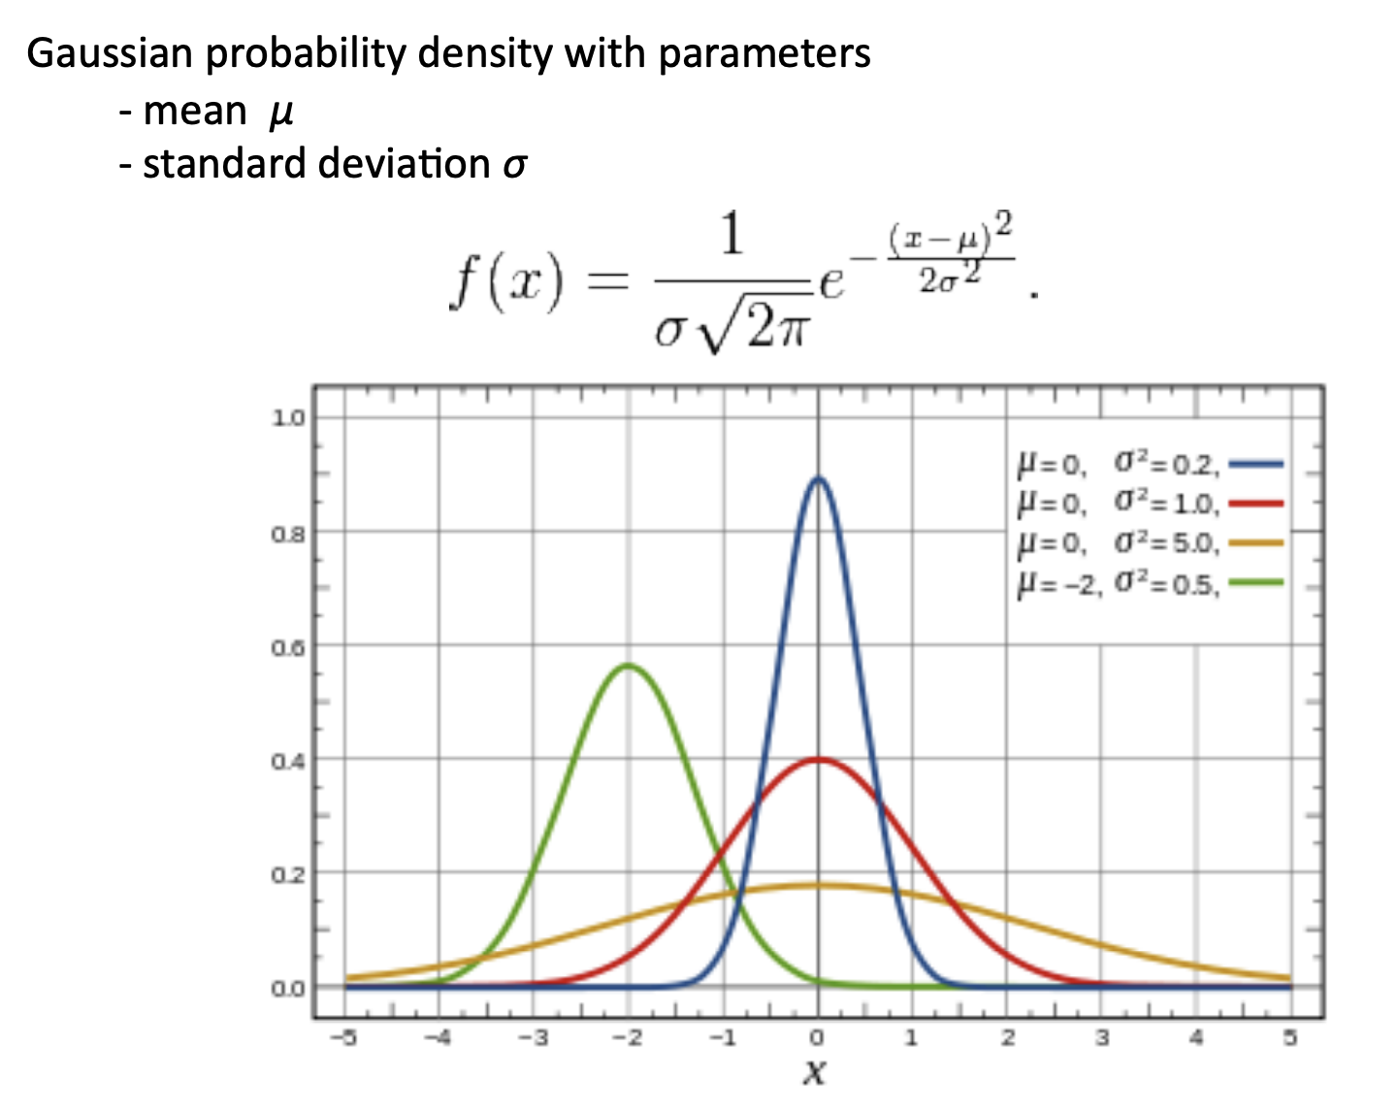
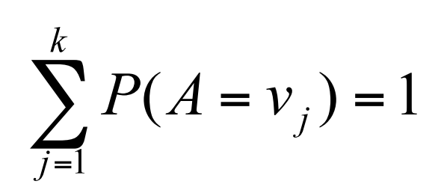
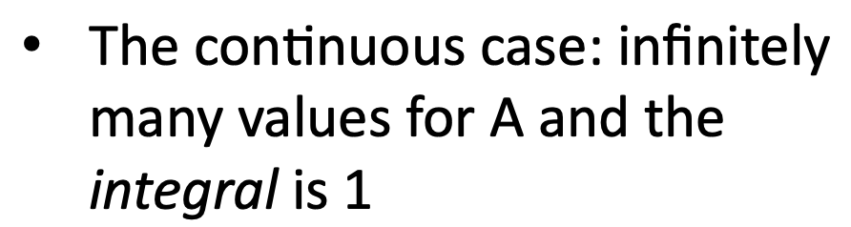
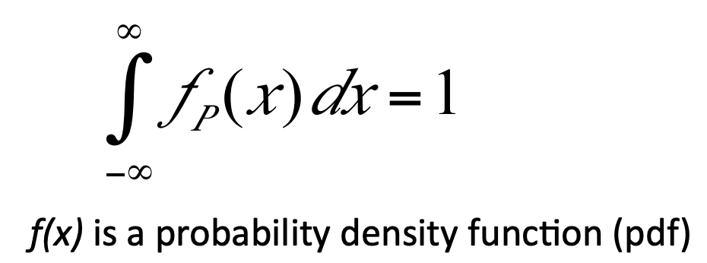
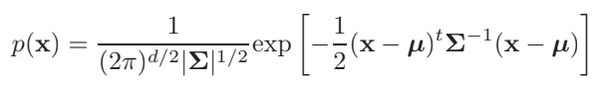
Random Sample

Slide 11
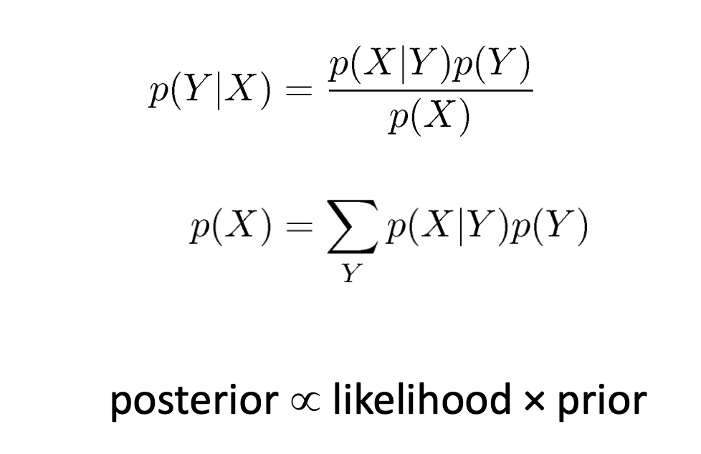
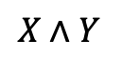

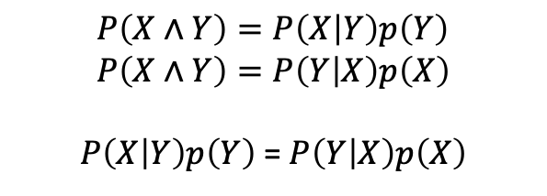
Bayes Theorem
$$X∧Y$$
X
Y
$$P\left(X∧Y\right)=P\left(X | Y\right)p\left(Y\right) \\ P\left(X∧Y\right)=P\left(Y | X\right)p\left(X\right)$$
$P\left(X | Y\right)p\left(Y\right)$ = $P\left(Y | X\right)p\left(X\right)$
posterior belief on the unknown label after you see data X
likelihood: How likely is the observed data under the particular unknown label Y
$P\left(Y | X\right)= \frac{P\left(X | Y\right)p\left(Y\right)}{\sum_{Y}{P\left(X | Y\right)p\left(Y\right)}}$
Prior belief on the unknown label before you see data X: Class probability

Slide 12
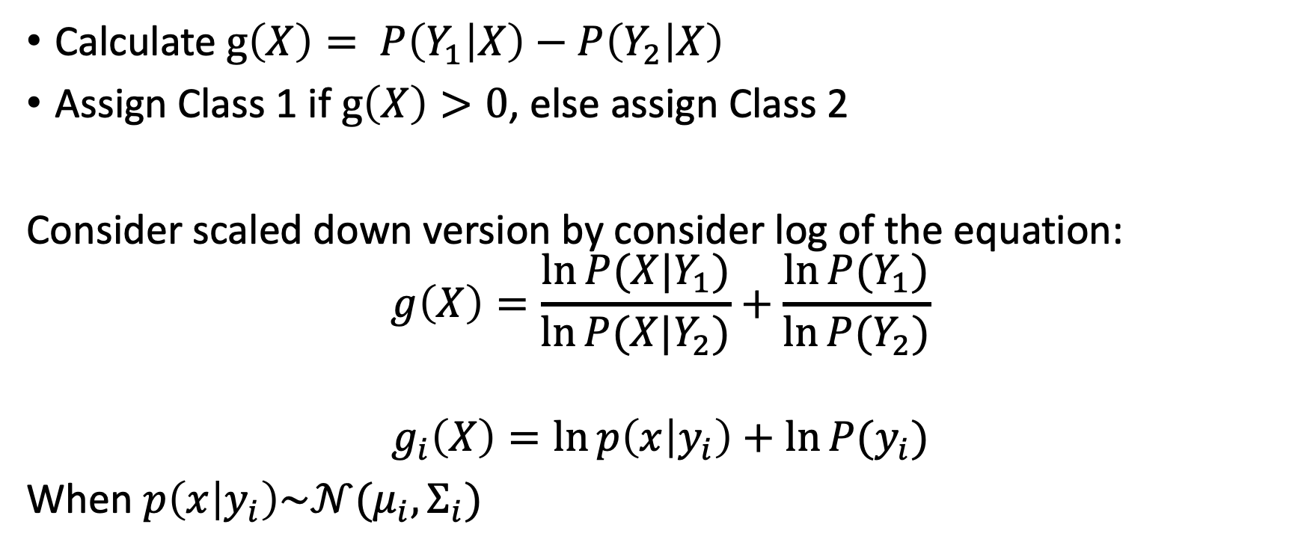
Bayes Classification
Calculate $g\left(X\right)= P\left(Y_{1} | X\right)−P\left(Y_{2} | X\right)$
Assign Class 1 if $g\left(X\right)>0$, else assign Class 2
Consider scaled down version by consider log of the equation:
$$g\left(X\right)=\frac{\ln{P(X|Y_{1})}}{\ln{P(X|Y_{2})}}+\frac{\ln{P(Y_{1})}}{\ln{P(Y_{2})}}$$
$$g_{i}\left(X\right)=\ln{p\left(x | y_{i}\right)+\ln{P(y_{i})}}$$
When $p\left(x | y_{i}\right)\sim 𝒩(μ_{i},Σ_{i})$

Slide 13
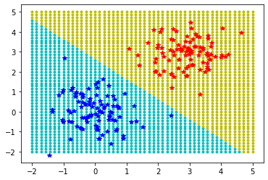
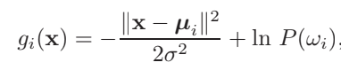
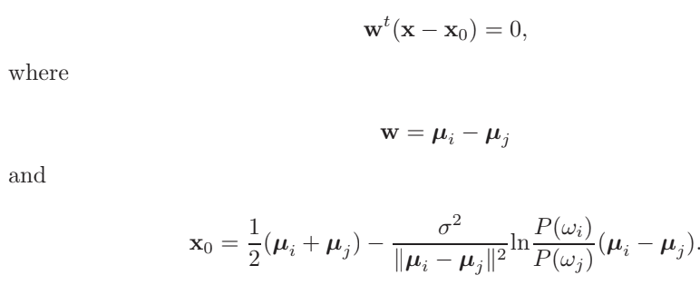
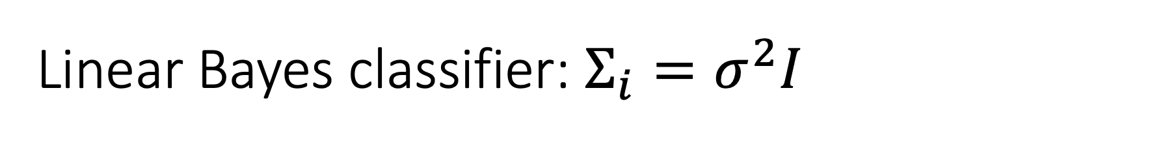
Linear Bayes classifier: $Σ_{i}=σ^{2}I$
Decision boundary is linear, orthogonal to the line joining two means

Slide 14
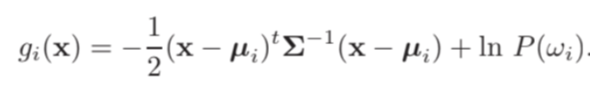
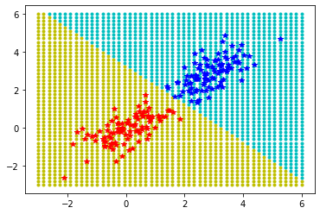
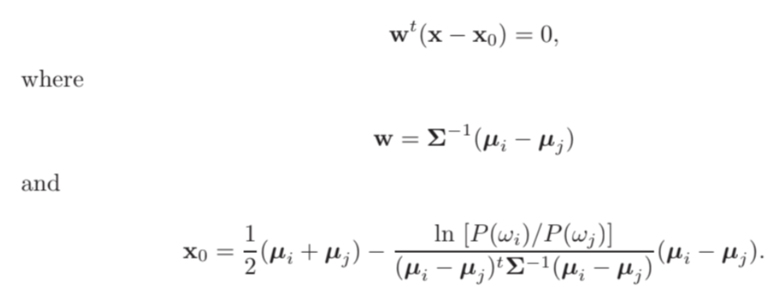
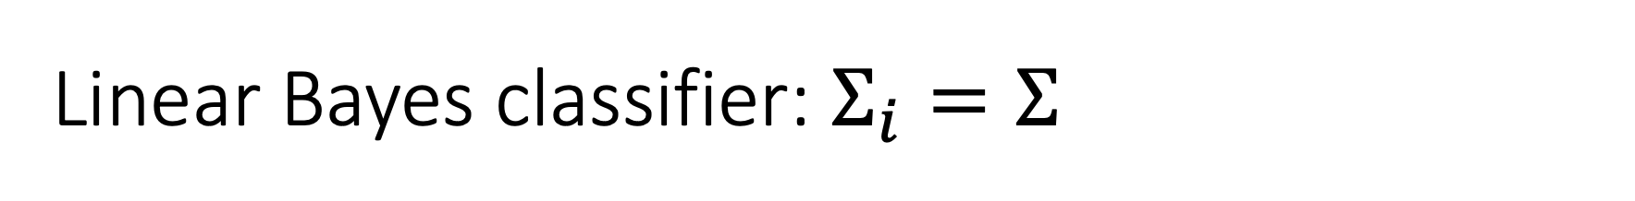
Linear Bayes classifier: $Σ_{i}=Σ$
Decision boundary is linear, but not orthogonal to the line joining two means

Slide 15
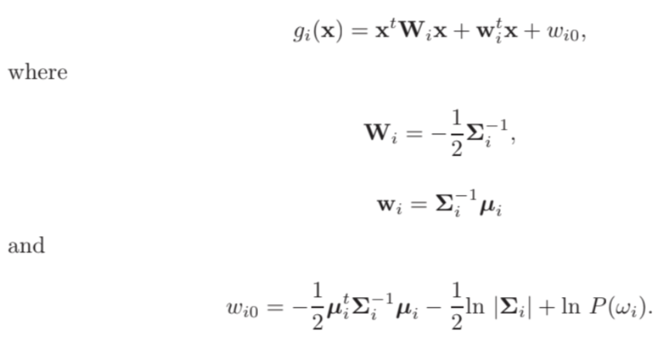
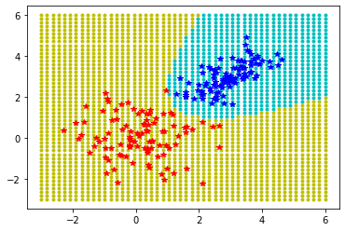
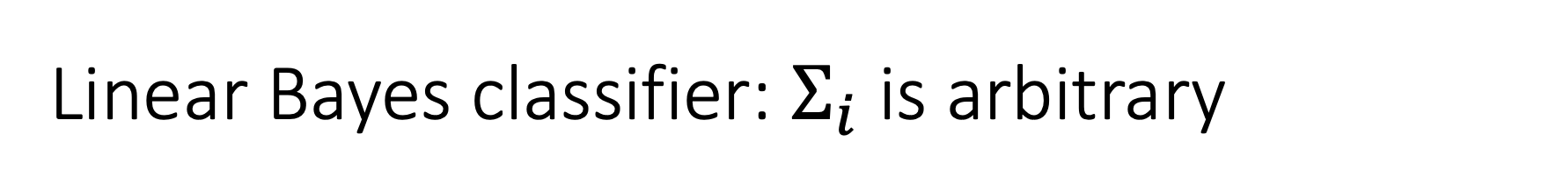
Linear Bayes classifier: $Σ_{i}$ is arbitrary
Decision boundary is hyperquadratics

Slide 16
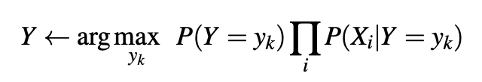
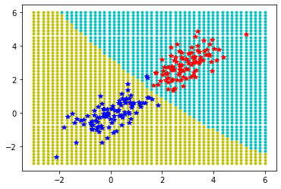
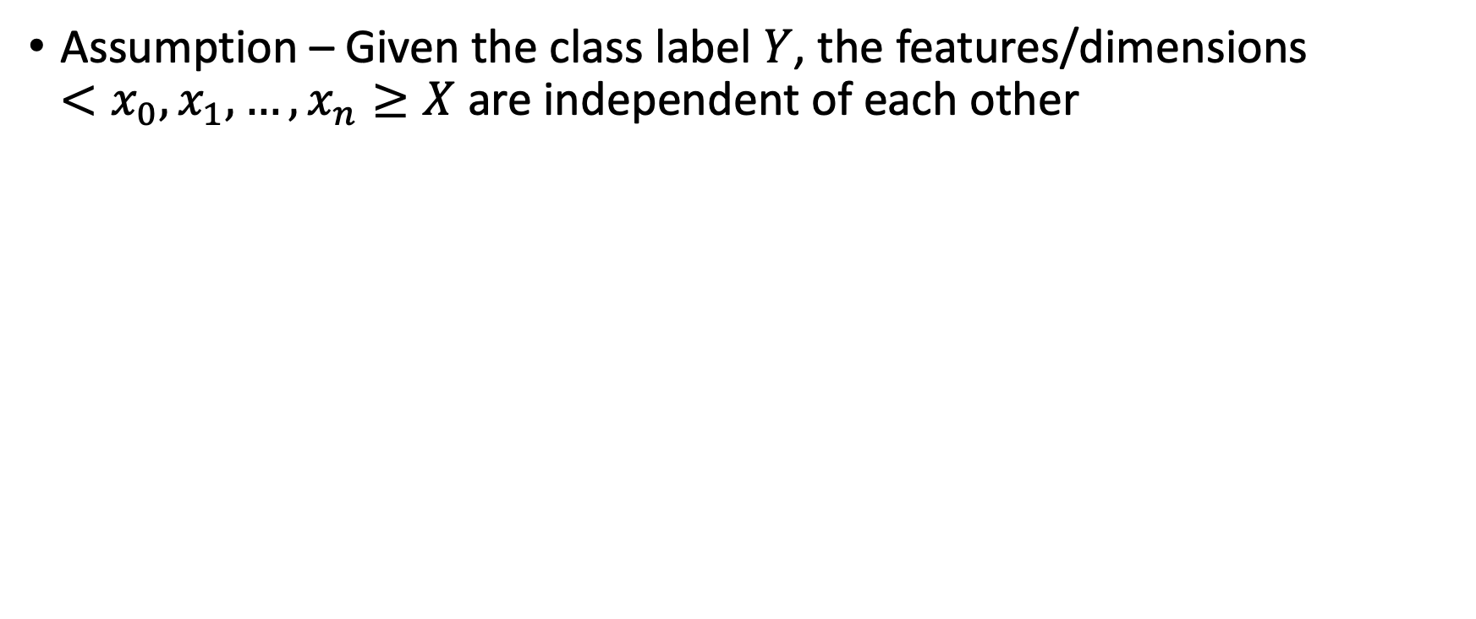
Naïve Bayes Classifier
Assumption – Given the class label $Y$, the features/dimensions $<x_{0},x_{1},…,x_{n}≥X$ are independent of each other

Slide 17

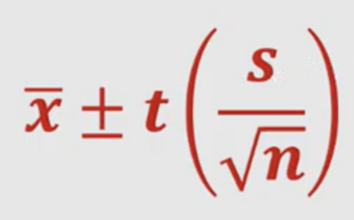
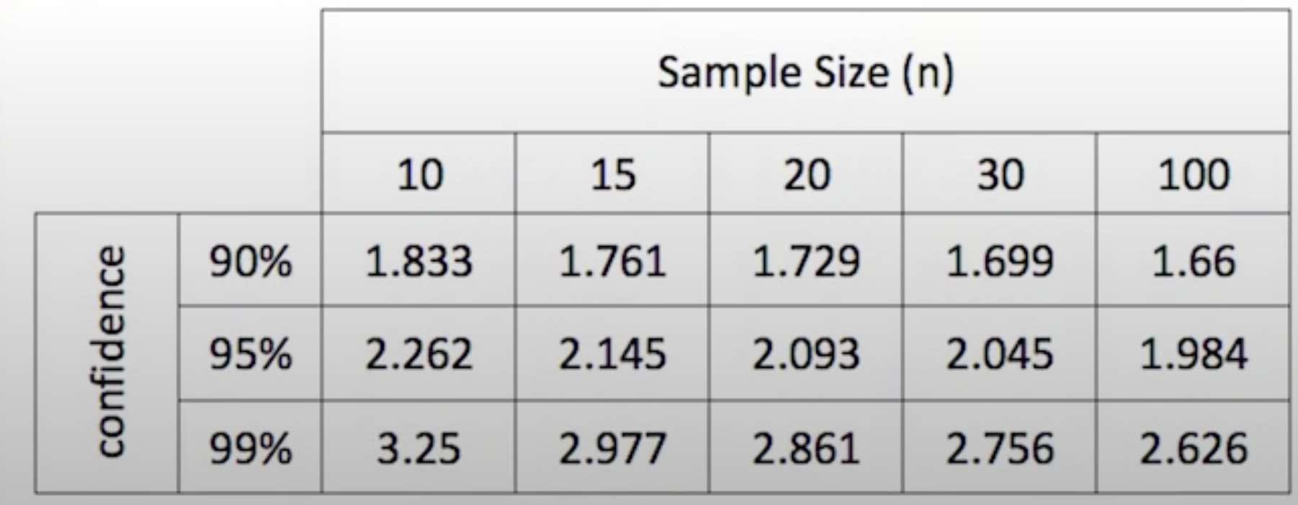
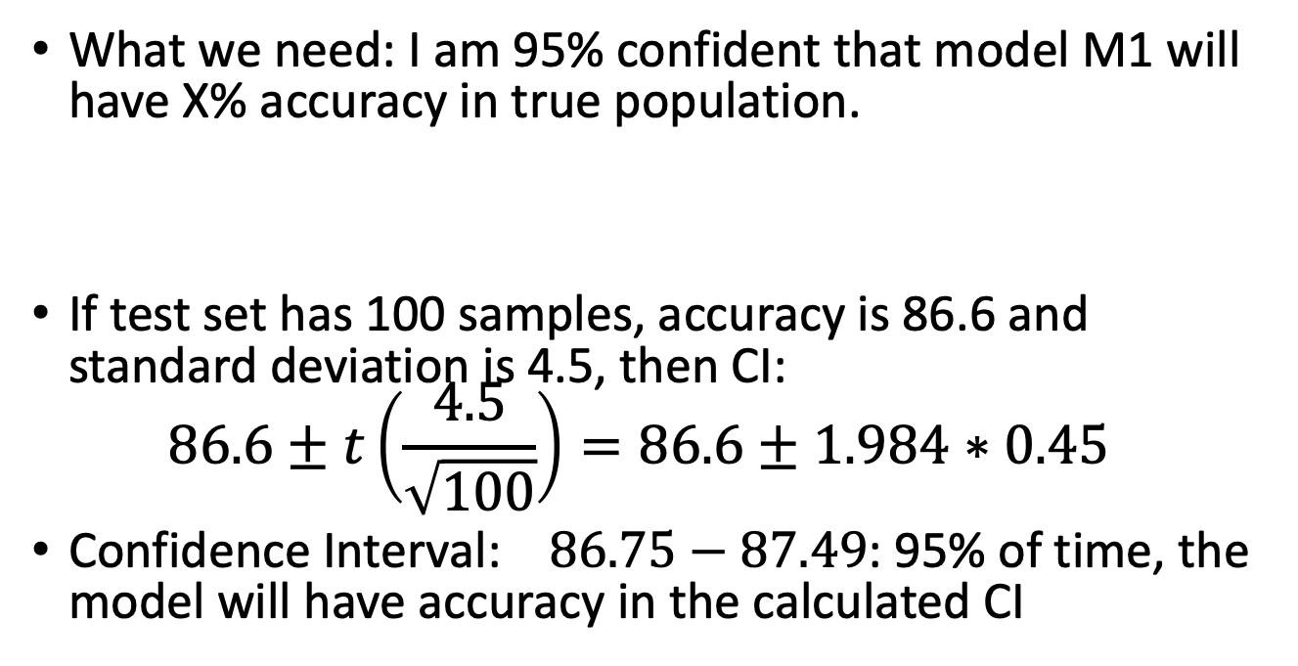
Evaluating model: Confidence Interval
Model M1 is X% accurate on test set (using randomized train test split)
Test set has been randomly sampled from true population
Is estimate on test sample generalization for the true population?
What we need: I am 95% confident that model M1 will have X% accuracy in true population.
If test set has 100 samples, accuracy is 86.6 and standard deviation is 4.5, then CI: $86.6±t\left(\frac{4.5}{\sqrt{100}}\right)=86.6±1.984∗0.45$
Confidence Interval: $86.75−87.49$: 95% of time, the model will have accuracy in the calculated CI

Slide 18
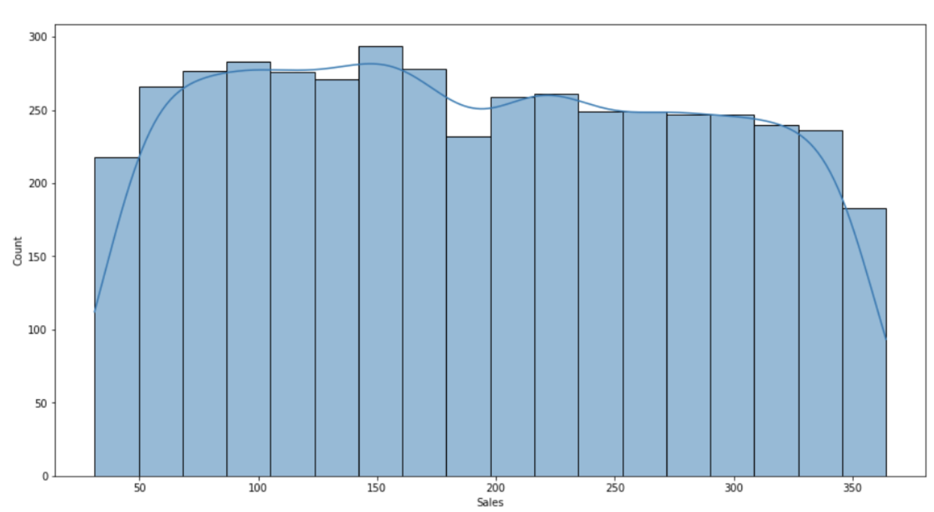
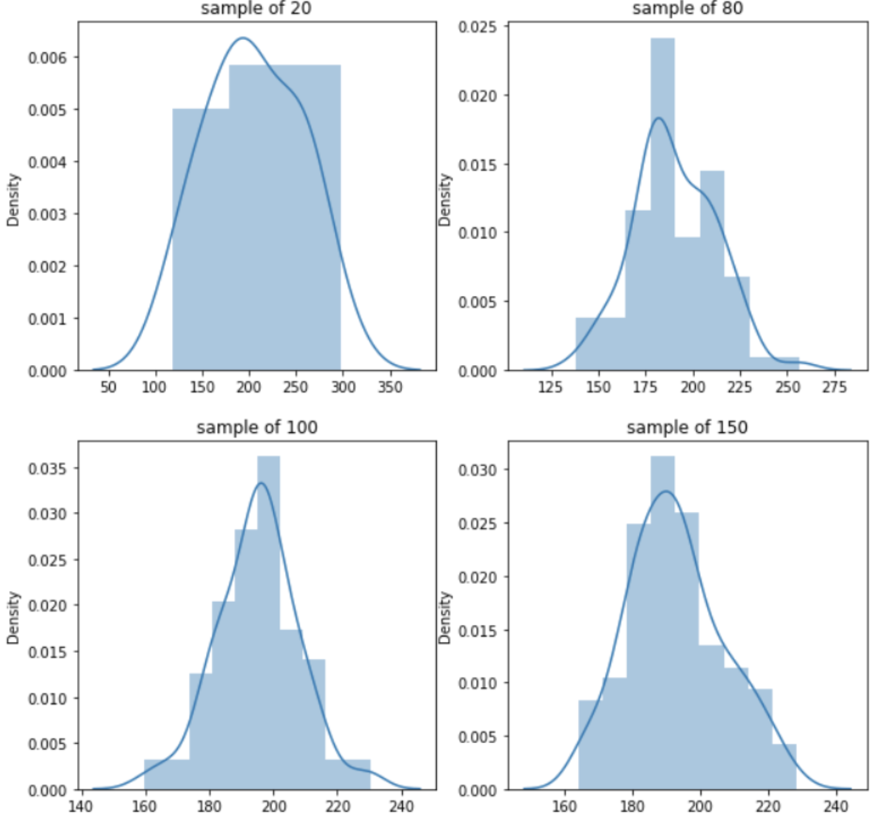
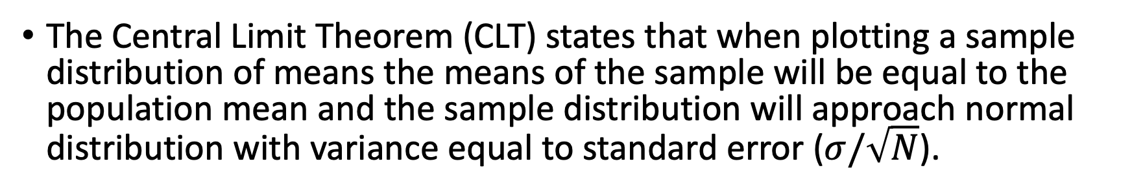
Central Limit Theorem: Why Gaussian distribution is so popular?
The Central Limit Theorem (CLT) states that when plotting a sample distribution of means the means of the sample will be equal to the population mean and the sample distribution will approach normal distribution with variance equal to standard error ($σ/\sqrt{N}$).
https://colab.research.google.com/drive/1IVwMPycIYaub-ayKnMmjVp8rqXfOuorr?usp=sharing

Slide 19
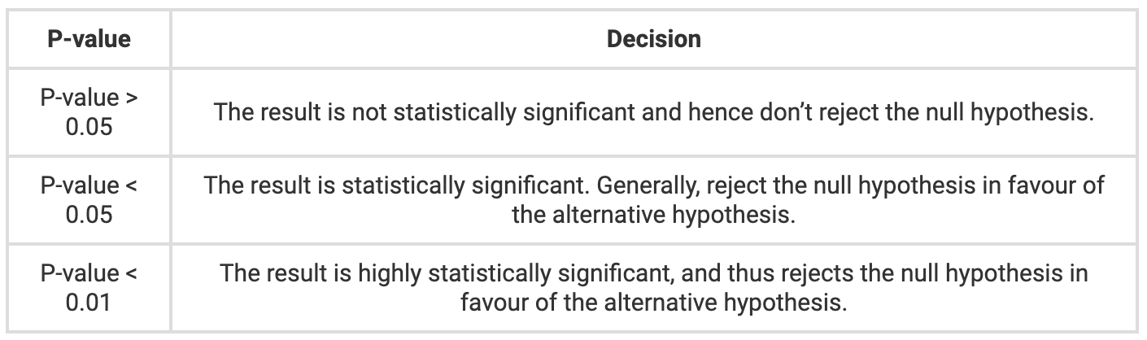
Hypothesis testing
Given two hypothesis, decide which hypothetic is more probable to happen as per the observed experimental data
Null hypothesis H0 is to be accepted or rejected against an alternative hypothesis H1
Calculate p-value. If the p-value is small then support the alternative hypothesis and reject the null hypothesis, and vice versa.
https://byjus.com/maths/p-value/

Slide 20
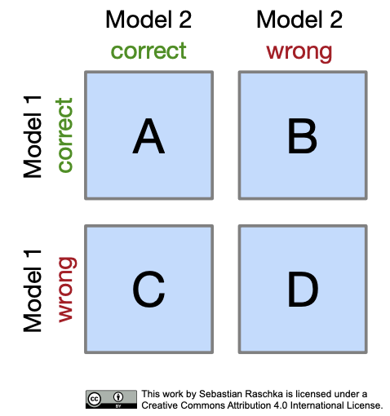
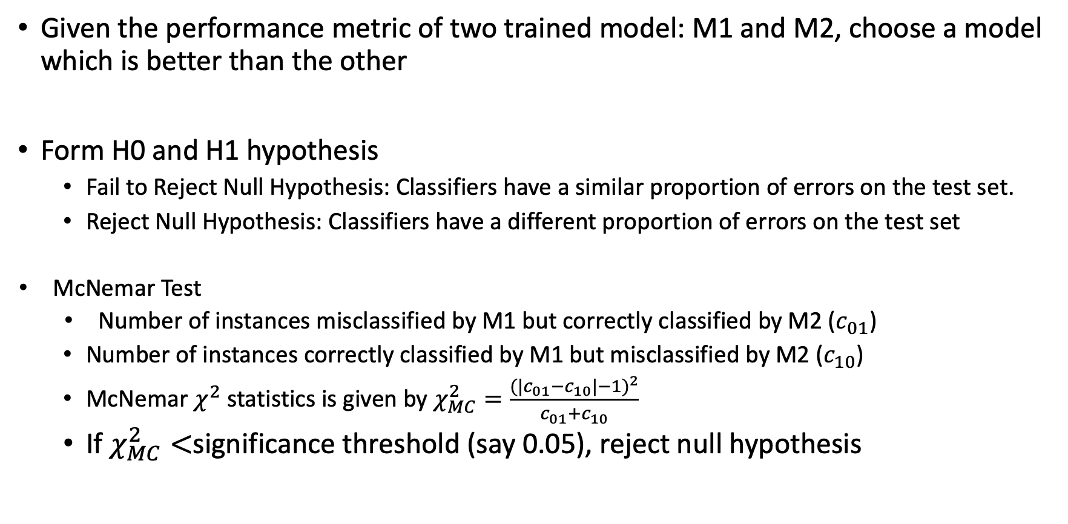
Hypothesis testing in Machine Learning
Given the performance metric of two trained model: M1 and M2, choose a model which is better than the other
Form H0 and H1 hypothesis
Fail to Reject Null Hypothesis: Classifiers have a similar proportion of errors on the test set.
Reject Null Hypothesis: Classifiers have a different proportion of errors on the test set
McNemar Test
Number of instances misclassified by M1 but correctly classified by M2 ($c_{01}$)
Number of instances correctly classified by M1 but misclassified by M2 ($c_{10}$)
McNemar $χ^{2}$ statistics is given by $χ_{MC}^{2}=\frac{{(|c_{01}−c_{10}|−1)}^{2}}{c_{01}+c_{10}}$
If $χ_{MC}^{2}<$significance threshold (say 0.05), reject null hypothesis
https://sebastianraschka.com/pdf/lecture-notes/stat479fs18/11_eval-algo_notes.pdf

